Slide 1
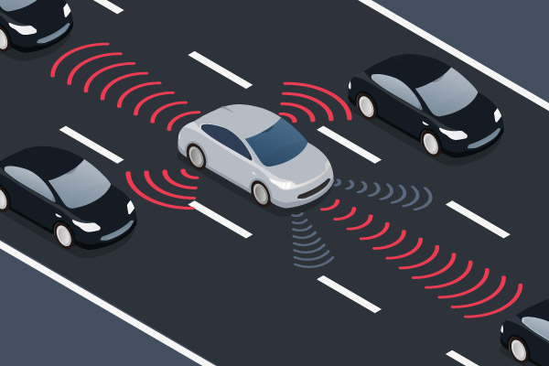
Self-Driving Car

Slide 2
Team : Innovation Skyline
Members :
1. Maksanlina Hossain Mitul -1421803043
2. Md. Junayet Hossain -1420979043
3. Tushar Mazhar Talukdar -1521237042

Slide 3
What is Self-Driving Car?
# An autonomous or self driving car is a vehicle that can guide itself without human conduction.
# This kind of vehicle has become a concrete reality and may pave the way for future systems where computers take over the art of driving.
# An autonomous car is also known as a driverless car, robot car, self-driving car or autonomous vehicle

Slide 4
How Self-Driving Car Works? The technological leaps and bounds we have made in recent years have finally culminated in making self-driving cars a reality. Self-driving cars are only possible today due to the existence of three technologies---
IoT Sensors : There are many types of sensors available today that make autonomous cars a reality. Sensors for blind-spot monitoring, forward collision warning, radar, camera, LIDAR, and ultrasonic all work together to make navigation of a self-driving car possible.
IoT Connectivity : Self-driving cars use cloud computing to act upon traffic data, weather, maps, adjacent cars, and surface conditions among others. This helps them monitor their surroundings better and make informed decisions. Self-driving cars must be connected to the internet even if edge computing hardware can solve small computing tasks locally.
Software Algorithms : All the data the car collects needs to be analyzed to determine the best course of action. This is the main function of the control algorithms and software. This is the most complex part of the self-driving car since it has to make decisions flawlessly

Slide 5
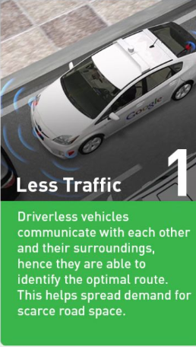
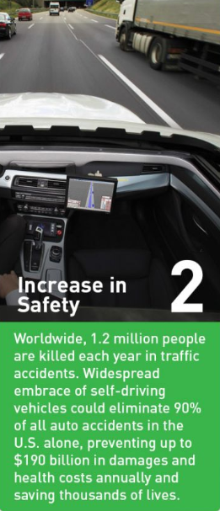
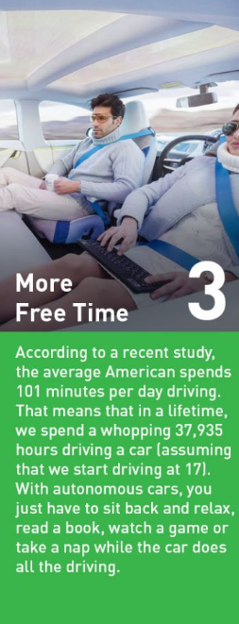
Benefits Of Self-driving Car

Slide 6
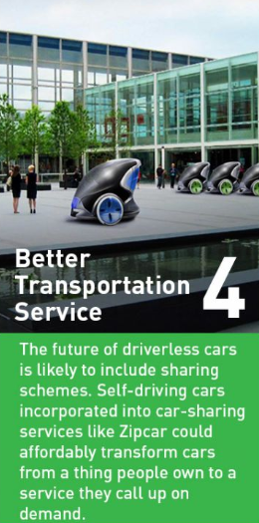
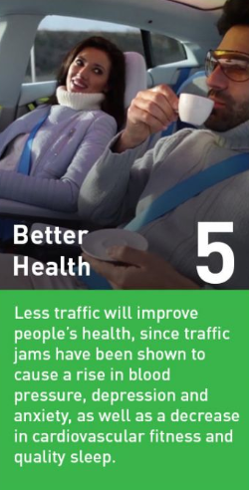
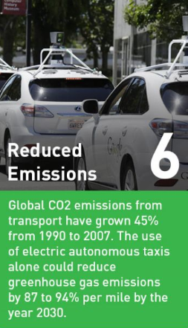
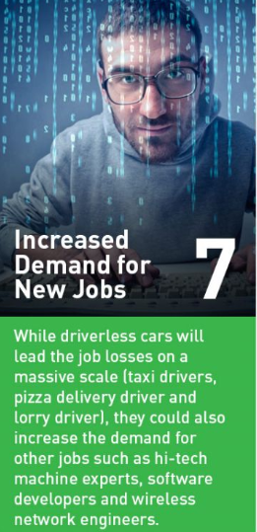
Benefits Of Self-driving Car

Slide 7
Project goal
Our goal for this project is to build a self driving car which will be able to function without human driver and run into roads by reading traffic lights , road signs ,detecting lane and other vehicles and pedestrians/objects.
This Project concept can be used:
1. Product transportation
2. Old people who are not capable of drive
3. This concept also can be used for making wheelchair, that will help the patients and many more……….

Slide 8
Basic Features Of Our self-Driving Car
Lane & Lane end Detection
Object Detection
Automatically lane change & come to the same lane
Traffic lights detection
Road sign Detection
Speed Limit Detection
By using map it will go one place to another

Slide 9
Hardware parts and use case
Hardware | Use case | Cost
Robo Car | This is our physical car | 800 Tk
L298H Bridge ( motor driver ) | Motor driver will be used for controlling all of our DC gear motors | 200 Tk
Power bank or battery | This is basically fuel for all of our hardware parts | 300 Tk
Raspberry pi | This is our main microcontroller , which will handle image processing and also able to perform task related to our machine learning, deep learning algorithm .This microcontroller will send all of the instructions to the slave device ( Arduino Uno ) | 4200 Tk
Raspberry pi camera | By using this camera module we will detect traffic lights, object ,lane , road signs etc | 600 Tk
Arduino Uno | This microcontroller is basically a slave device Device , it will receive instruction from main microcontroller( raspberry pi ) and according to the instructions , this will control our motors | 400 Tk
16GB SD card | SD card is necessary for store our raspberry pi operating system and all logical code | 300 Tk
USB cables and wires | USB cables & wires will be used for connect all of our hardware | 200 Tk
Other necessary equipment |  | 400 Tk
 | Total Cost = | 7,400 tk ( Apprx )

Slide 10
Software and Algorithm
We will use “ OpenCV ” for image & video processing
We will use C++ & python for different task
We will create “cascade machine” learning model to detect lane, objects / obstacles, traffic lights, road signs and for different task

Slide 11
What is Cascade Model?
One of the original goals of computer vision was to fully understand a natural scene. This requires solving several sub-problems simultaneously, including object detection, region labeling, and geometric reasoning.
In this work, we consider learning a set of related models in such that they both solve their own problem and help each other.
We will develop a framework called Cascaded Classification Models (CCM), where repeated instantiations of these classifiers are coupled by their input/output variables in a cascade that improves performance at each level.

Slide 12
How will we build our autonomous car?
Step-1 : Hardware Assembles
Step-2 : Necessary Packages Installation for Raspberry Pi
Step-3 : Relation creation between the master device and a slave device
Step-4 : Camera setup –Real world implication- Camera will be used to collect data for detecting traffic lights, lanes, read road signs, track other vehicles, and look for pedestrians .Camera collect the data for analysis and suitable actions are taken according to codes
Step-5 : Working with openCV – For image processing
Step-6 : Working with machine learning & neural network
Step-7 : Cascade model creation- for detect
1. Lane
2. Object
3. Road signs
4. Traffic signals and may more features

Slide 13
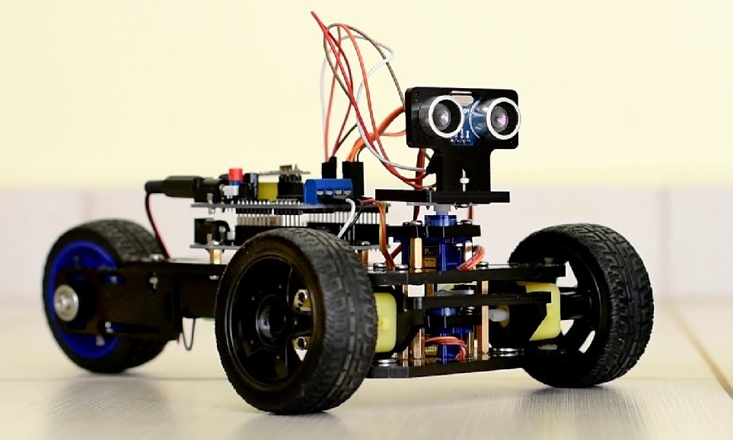

Slide 14
Demo of Our Project

Slide 15
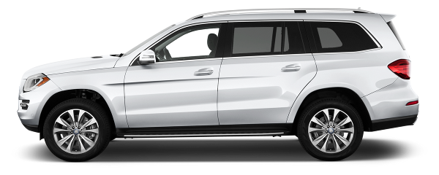
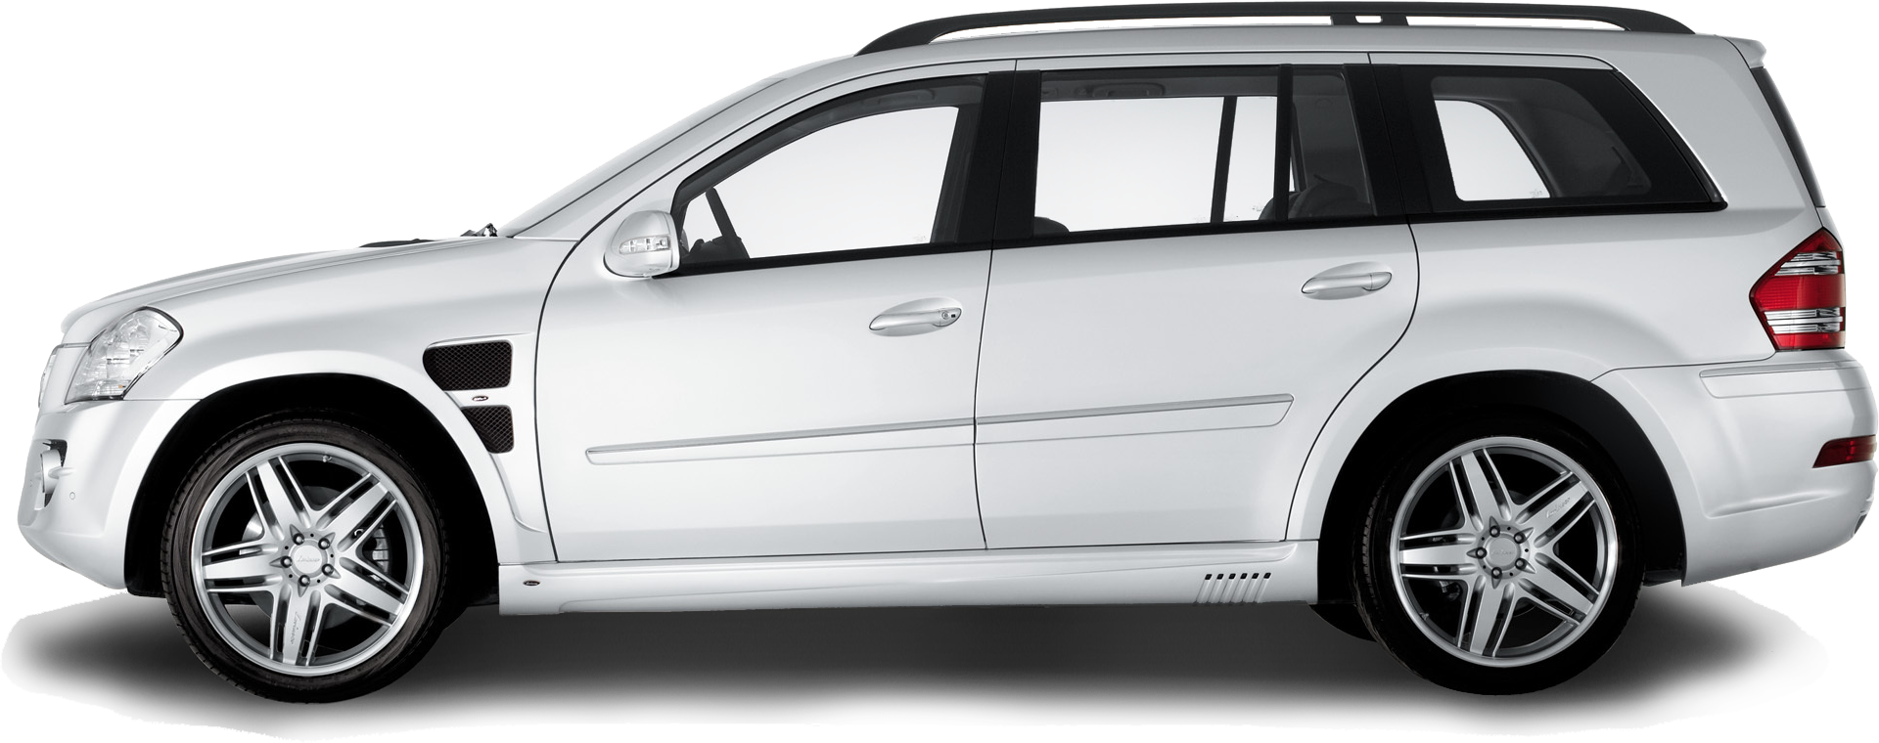
Group -03
Tushar Mazhar Talukdar
Maksanlina Hossain Mitul
Md. Junayet Hossain Khan
Car Will Change The lane when It will see object in-front it & after cross the object it will back to its own lane and move on
Self-Driving Car Project
Green Light On ( Car will not stop )
Red Light On ( Car will stop )
Speed Breaker ( Car will reduce its speed)
Sylhet
Dhaka
Back To previous Destination
Bus Stand
Bus Stand
This Photo by Unknown Author is licensed under CC BY-NC
This Photo by Unknown Author is licensed under CC BY-NC
This Photo by Unknown Author is licensed under CC BY-NC
This Photo by Unknown Author is licensed under CC BY-NC

Slide 16
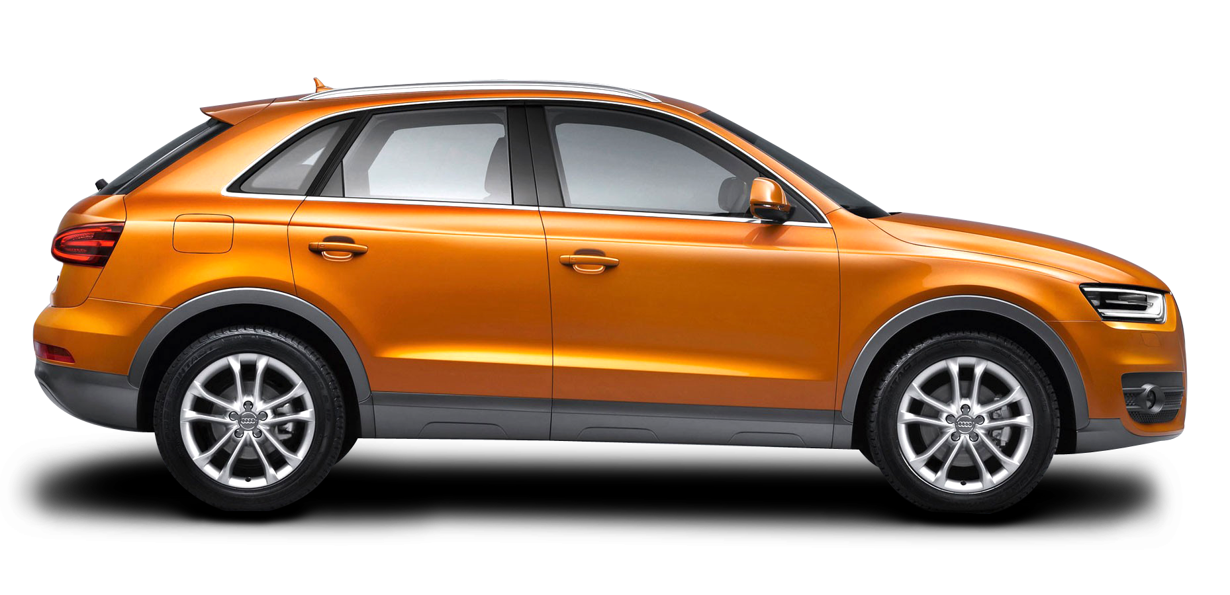
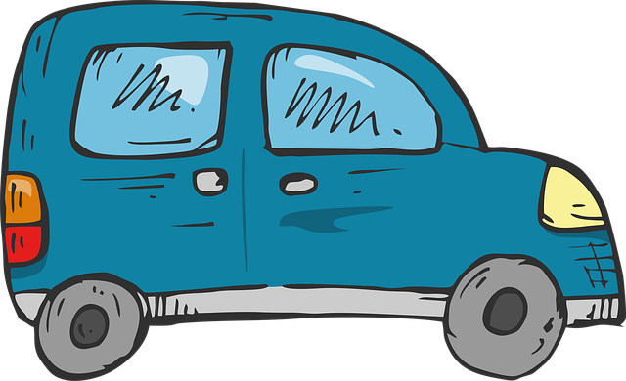

Slide 17


Slide 20
Speed Limit reduce

Slide 21
Speed Limit reduce

Slide 22
Speed Limit reduce

Slide 23
Road Finished
Turn to second lane

Slide 24
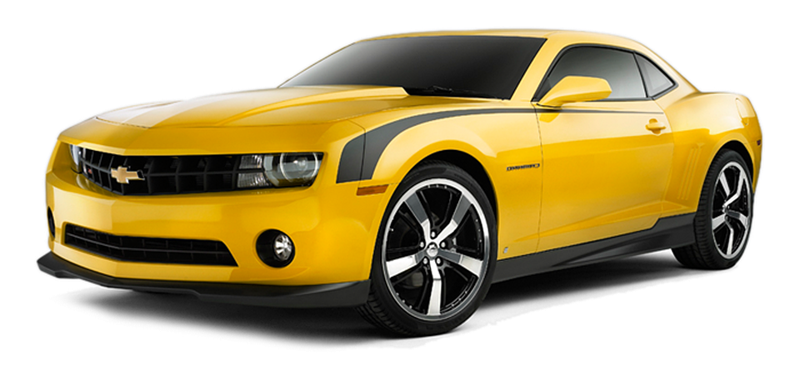
Road Finished
Turn to second lane

Slide 25
Project Progress
Progress scale | Level-1 | Level-2 | Level-3 | Level-4
So far, we have understood the concept of self-driving cars and details of features as well as how it works.
We also acknowledged the hardware requirements and estimated a cost for the project.
We bought all of our hardware and made a physical car
Then, we will gradually implement our machine learning algorithms to make our car autonomous

Slide 26


